Slide 1
Neuroscience and Online Learning
Steven I. Friedland
May 2020

Slide 2
Goal
To Show how educational neuroscience can assist learning law online.

Slide 3
The Problem: Online Learning Can Be
1. Fatiguing,
2. Distracting,
3. Un-Motivating, &
4. Easily Forgotten

Slide 4
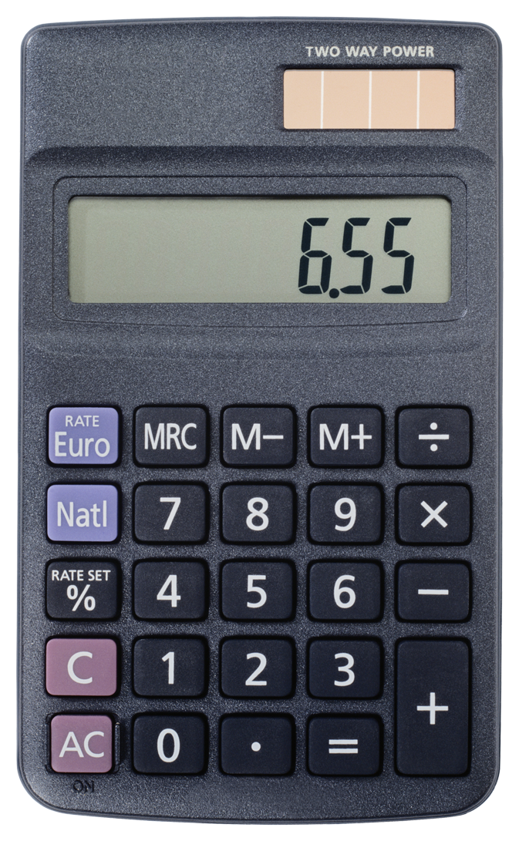
Problem #1: Fatigue
Conscious mind = Slow, effortful and uncertain
Unconscious mind = major usage, fast and effortless, based on patterns and categories (short-cuts). Often wrong.
Notes:
Terry Doyle & Todd Zakrajsek, The New Science of Learning: How to Learn in Harmony With Your Brain 5–7 (2013). A “brain is reluctant to abstract. Its processing occurs within dedicated sensory and motor systems, configured to identify the physical state of the external world and to prepare the right actions. With its sensory and motor towers, the brain is designed to pull out patterns within patterns, and to integrate information across senses to make best guesses about the external world and generate appropriate behaviours.” Michael S.C. Thomas, The Brain Doesn’t Like to Abstract Unless You Make It, How the Brain Works, http://www.howthebrainworks.science/how_the_brain_works_/the_brain_doesnt_like_to_abstract_unless_you_make_it/ (last visited June 24,
Why Thinking About Paying Attention to Something Helps You Remember It, Bus. Insider (Sept. 27, 2012, 1:57 PM), https://www.businessinsider.com/paying-attention-improves-memory-2012-9 (referring to a 2012 study published in the Proceedings of the National Academy of Sciences and titled, “Nucleus Basalis-Enabled Stimulus-Specific Plasticity in the Visual Vortex is Mediated by Astrocytes.” Naiyan Chen et al., Nucleus Basalis-enabled Stimulus-specific Plasticity in the Visual Cortex is Mediated by Astrocytes, 109 Proc. Nat’l Acad. Sci. U.S. 16427 (2012)). 2019).

Slide 5
Example: The bat and the ball
A bat and a ball together cost $1.10.
The bat cost $1 more than the ball.
How much does the ball cost?

Slide 6
Strategies For Fatigue
1. Use lots of breaks and pomodoro
A. Stretch & recover (diffuse vs. focused thinking)
2. Use unconscious conditioning system: happy faces
Notes:
Brains produce Ethos, Pathos, Logos – Character, Emotion, and Logic.
These systems include episodic (memorizing events), conceptual (spotting patterns), conditioning (unconscious learning in the limbic system from past behavior), controlling systems, reward-based (using the dopamine neurotransmitter), procedural (for learning frequent activities), observation (modeling others), and instructions. Thomas,

Slide 7
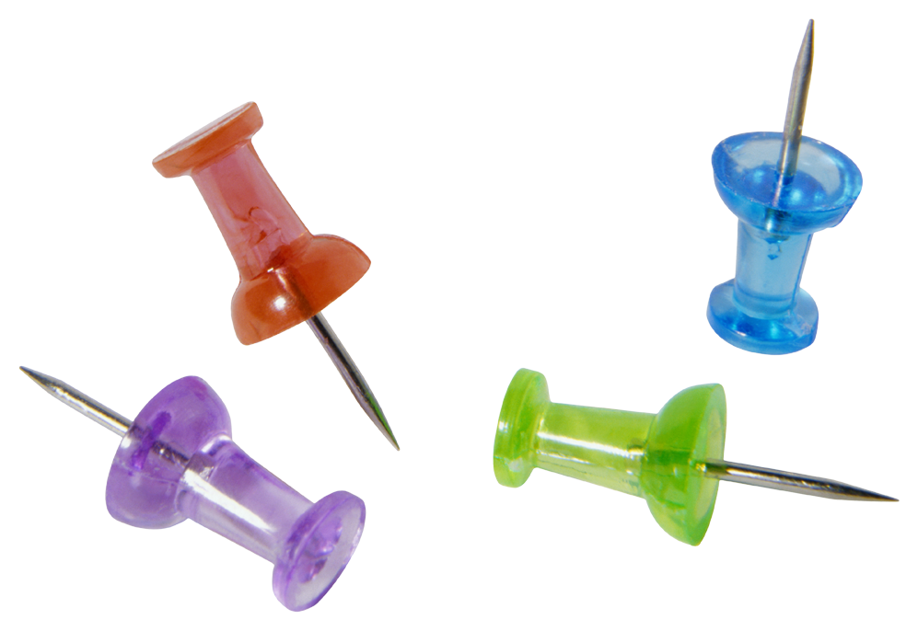
Problem #2: Distraction
To Learn: Pay attention. Abstraction difficult.
Pay attention – to what?
“Multi-tasking – “violates everything scientists know about memory formation.”

Slide 8
The Brain and Memory
Inputs
unlimited
Working Memory
Temporary storage
Lots discarded
Remember 8
Long-term Memory
Storage strength
Retrieval strength

Slide 9
Strategies for Distraction
1. Reframe online as mobile learning
2. Front load Prior to Class – directed reading, probs., Qs; videos, podcasts, student Qs
3. Engage With Deliverables:
Small groups, all write, post, outline, provide perspectives, find, interview, pair-share, jigsaw

Slide 10
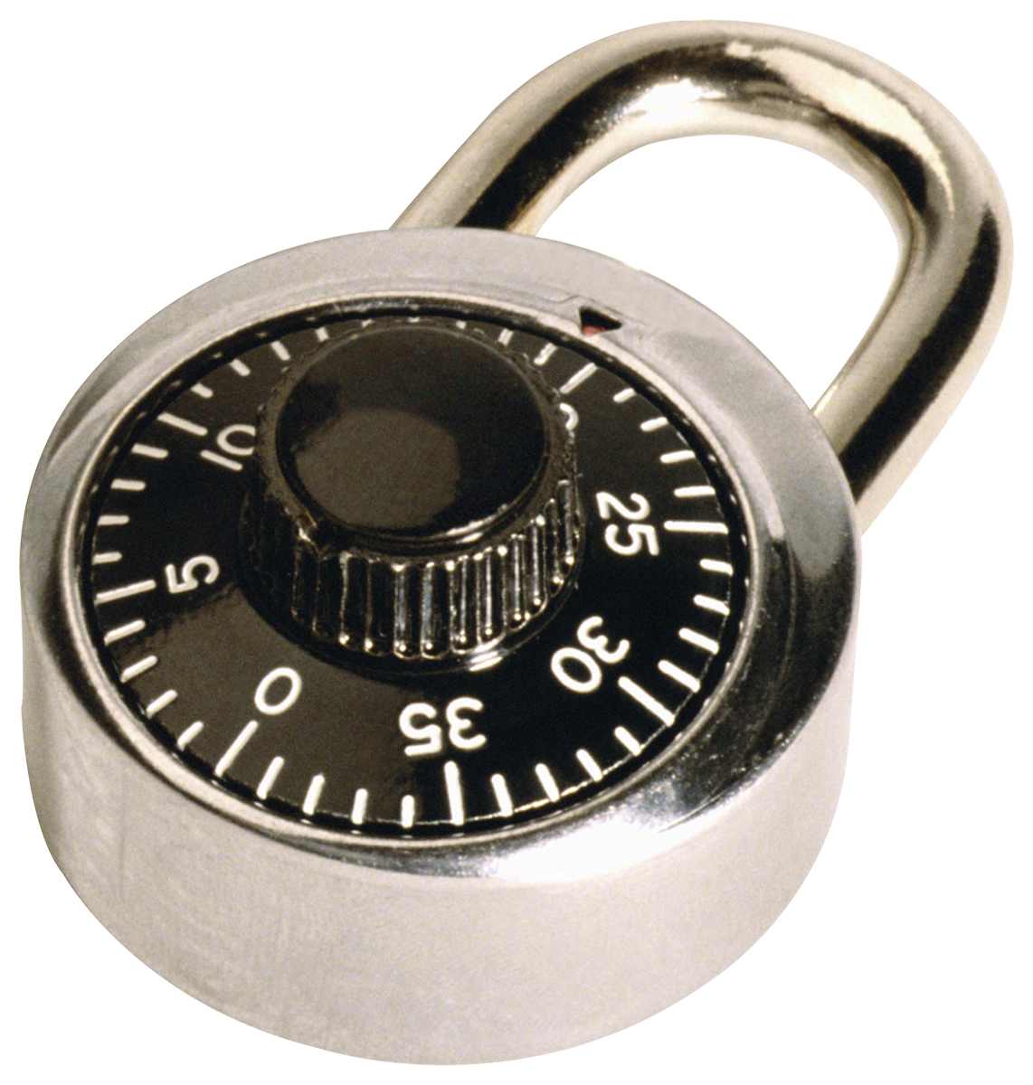
Problem #3: Motivation
Relates to fatigue and distraction, but important
Neuroscience: Emotion and cognition are partners in thinking & learning. (Emotive Cognition.)
Law School is not dependent on cognitive reasoning ability alone.

Slide 11
Strategies for Motivation
(1) Use moderate emotion to enhance learning
A. Well-Being is important in Legal Education
1. Gratitude and fun matter to learning
2. Create Settled Expectations
3. Create Curiosity
B. Use Narratives to promote memory

Slide 12
Create Context
During WWII, people of Japanese ancestry were sent to
“relocation centers” under Executive Order 9066. Which
statement is the most accurate?
2,000 people were relocated from Peru to the United States.
Five relocation centers were on an Indian Reservation.
More than 30,000 children under ten years of age were relocated.
People were first removed to Assembly Centers, including horse stables, such as Santa Anita Raceway.

Slide 13
Use Competition and the Brain’s Dopamine Reward System
Between 1525 and 1866, how many Africans were forcibly taken as slaves directly to North America?
12.5 million
10.7 million
1.8 million
380 thousand
[the Trans-Atlantic Slave Database]

Slide 14
Problem #4: Neuroscience Says Long-term Learning is difficult
1. The brain is not like a computer (multiple systems; can be effortful to encode, store and retrieve information; interferences)
2. Need repetitive attention to achieve deep chunked knowledge (utensil set).
3. Can melt if not used.
4. Built on top of existing knowledge
Notes:
A brain cannot store information indefinitely, unless it has been moved to long-term memory, and even then, recall is not automatic. Further, the brain and its memory are affected by stress, anxiety

Slide 15
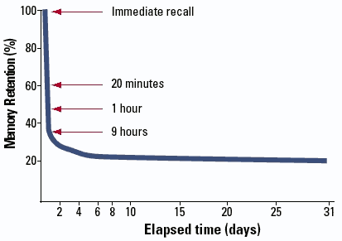
The Forgetting Curve
Memory
Percent
Retained
Time in days
Notes:
According to Ebbinghaus, the storage of information in the brain is taxed by a forgetting curve—people rapidly forget what they learn. Within an hour, people forget on average fifty percent of what they learned, and seventy percent in less than one day. “Left to itself every mental content gradually loses its capacity for being revived, or at least suffers loss in this regard under the influence of time. Facts crammed at examination time soon vanish, if they were not sufficiently grounded by other study and later subjected to a sufficient review. But even a thing so early and deeply founded as one’s mother tongue is noticeably impaired if not used for several years.” Hermann Ebbinghaus, Memory: A Contribution to Experimental Psychology 4 (Henry A. Ruger & Clara E. Bussenius trans., 1913) (1885), https://archive.org/details/memorycontributi00ebbiuoft/page/n6.
. Art Kohn, Brain Science: The Forgetting Curve – the Dirty Secret of Corporate Training, Learning Solutions (Mar. 13, 2014), https://www.learningsolutionsmag.com/articles/1379/brain-science-the-forgetting-curvethe-dirty-secret-of-corporate-training.
. Id.

Slide 16
Better Strategies for Long-Term Learning?
Spaced Repetition vs. Cramming
Regular Quizzing vs. 1 Exam
Interleave vs. one topic

Slide 17
Create Schemas (pictures)
Offered to prove what?
The Evidence Highway
To Impeach?
*
Intrinsic
Extrinsic
Rehab.
To Prove Element?
Relevant
Character
Opinion
Hearsay
Privilege
Witnesses
Writings
GOAL: IN EVID.

Slide 18
“The Big House of Due Process"

Slide 19
Spaced Rep: Wash, Rinse, Repeat
A. Beginning of class: bridge from prior classes
B. Middle of class: note breaks
C. End of Class: Survey. Ask what are the most important point(s)? What’s fuzzy and why?

Slide 20
Review: How Neuroscience Applies to Online Learning
1. Limit fatigue with settled expectations, mobile learning
2. Limit distraction with emotion: narratives; competition; well-being, small groups
3. Motivate with competition, well-being, social learning
4. Promote engaged long-term learning with spaced repetition, schemas, interleaving

Slide 21
The End
Finish each day and be done with it. You have done what you could. Some blunders and absurdities no doubt crept in; forget them as soon as you can. Tomorrow is a new day. You shall begin it serenely and with too high a spirit to be encumbered with your old nonsense.” ~ Ralph Waldo Emerson
“Can’t nobody get me down, oh no.”
~ P. Diddy

