Slide 1
Established Systems, Legacy Systems, and Technical Debt
A presentation by:
Elmer Masters, CALI
John Joergensen, Rutgers Law
June, 2018

Slide 2
Legacy Systems
Home brew
Customized systems
Complex turnkey systems

Slide 3
Complex Vendor Systems
Library management systems
Admissions systems
Career Placement systems
Student records
Financial aid
Exam automation
etc

Slide 4
Customized Systems
See above
Nothing works when you turn it on.

Slide 5
Locally Developed Applications
Exam bank
Online seating charts
WordPress?
Drupal?
LMS/Admissions/FA/Career placement

Slide 6
The “Crisis” of Law I.T.
Outsourcing
Competition for expertise
Interest!
Maintenance is not interesting.
Incremental improvement will not make a career.
Old code is not “cool”.

Slide 7
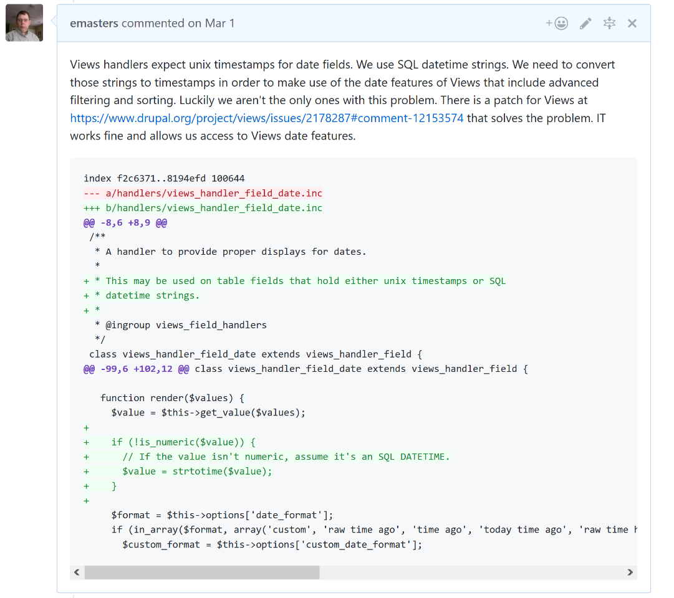
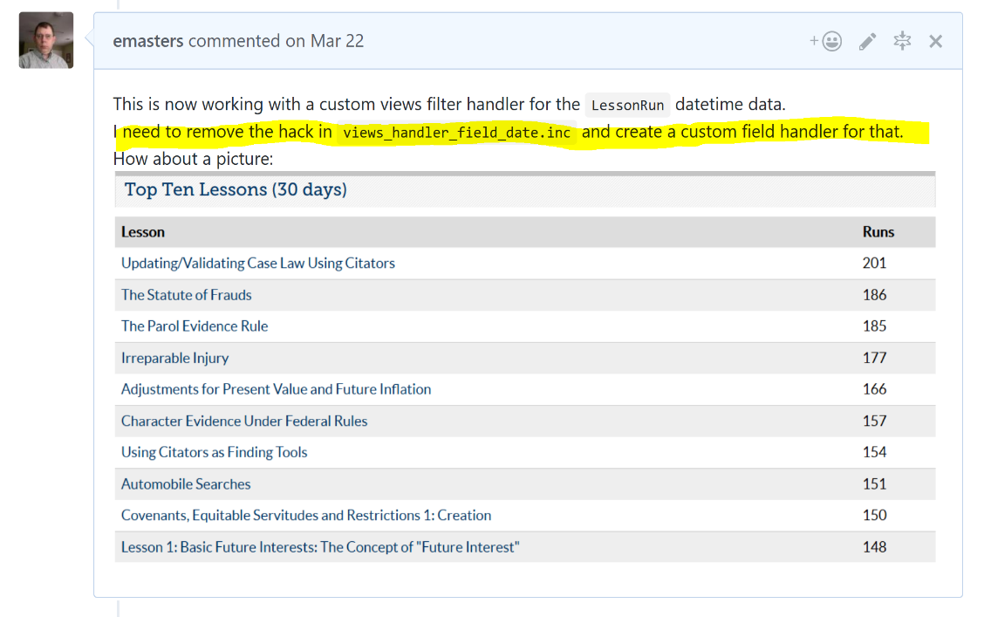
Technical Debt

